Slide 1
Who Knows Ammar?
Notes:
Do you know Amar? No? Really? I am sure you do

Slide 2
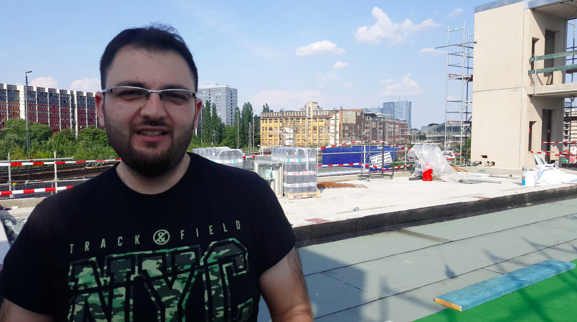
http://ammarify.herokuapp.com
Notes:
He is Ammar, he looks happy and he is perfectly integrated in Germany. But if we take a step back, there is a lot of people that when arrives, they don’t speak the language, they don’t know what to do, and they are completely lost.

Slide 3
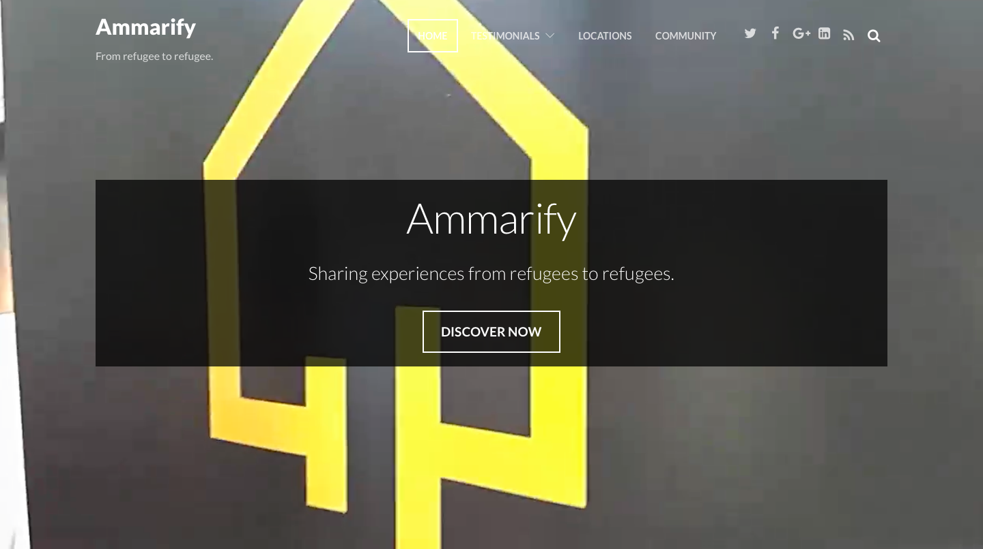
Notes:
So we created, Ammarify, a community to share experiences from refugees to refugees. We solve uncertainty and insecurity problem, offering support from fellows.

Slide 4
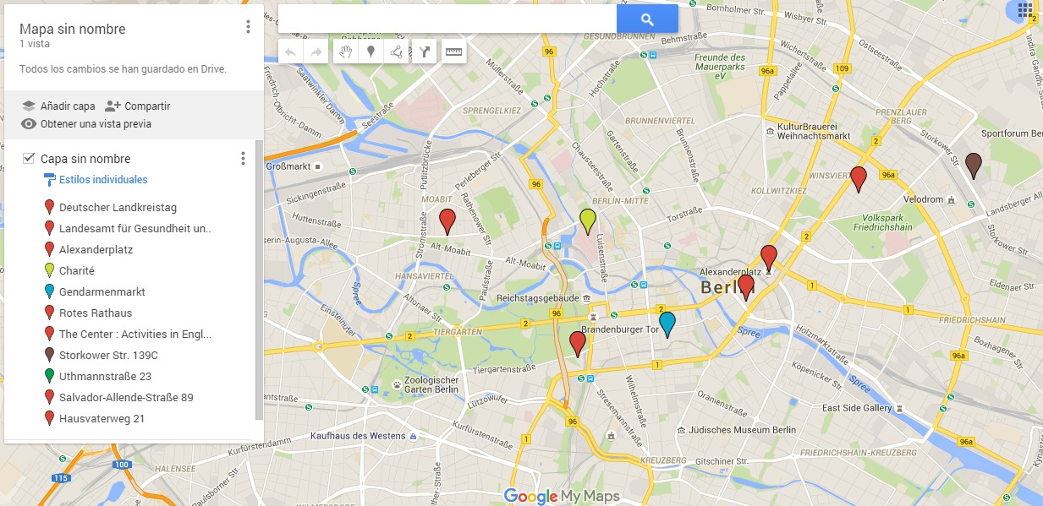
Notes:
But how does it works? We place beacons through the city to empower the refugees with useful information in their own language. For example, if I am in the HouseK, because I want to rent a room. I may miss same papers, dont know exactly where to go, etc.

Slide 5
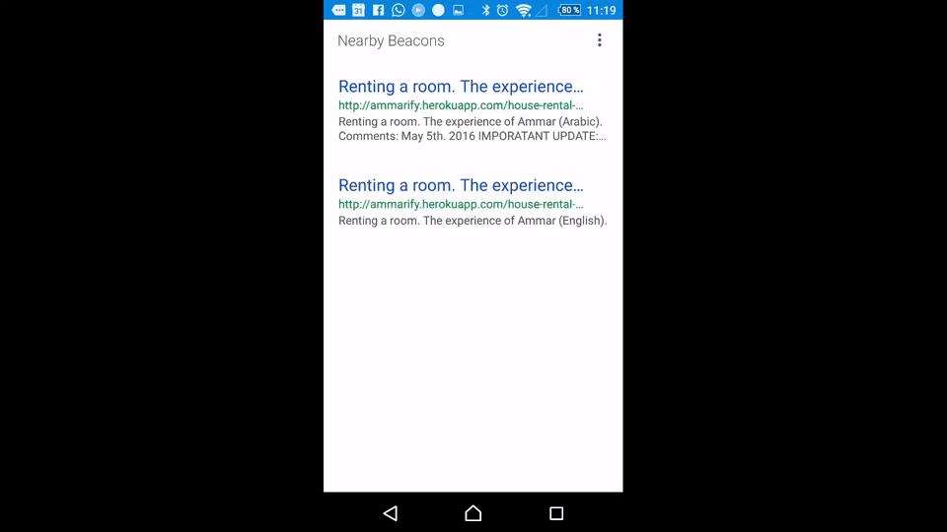
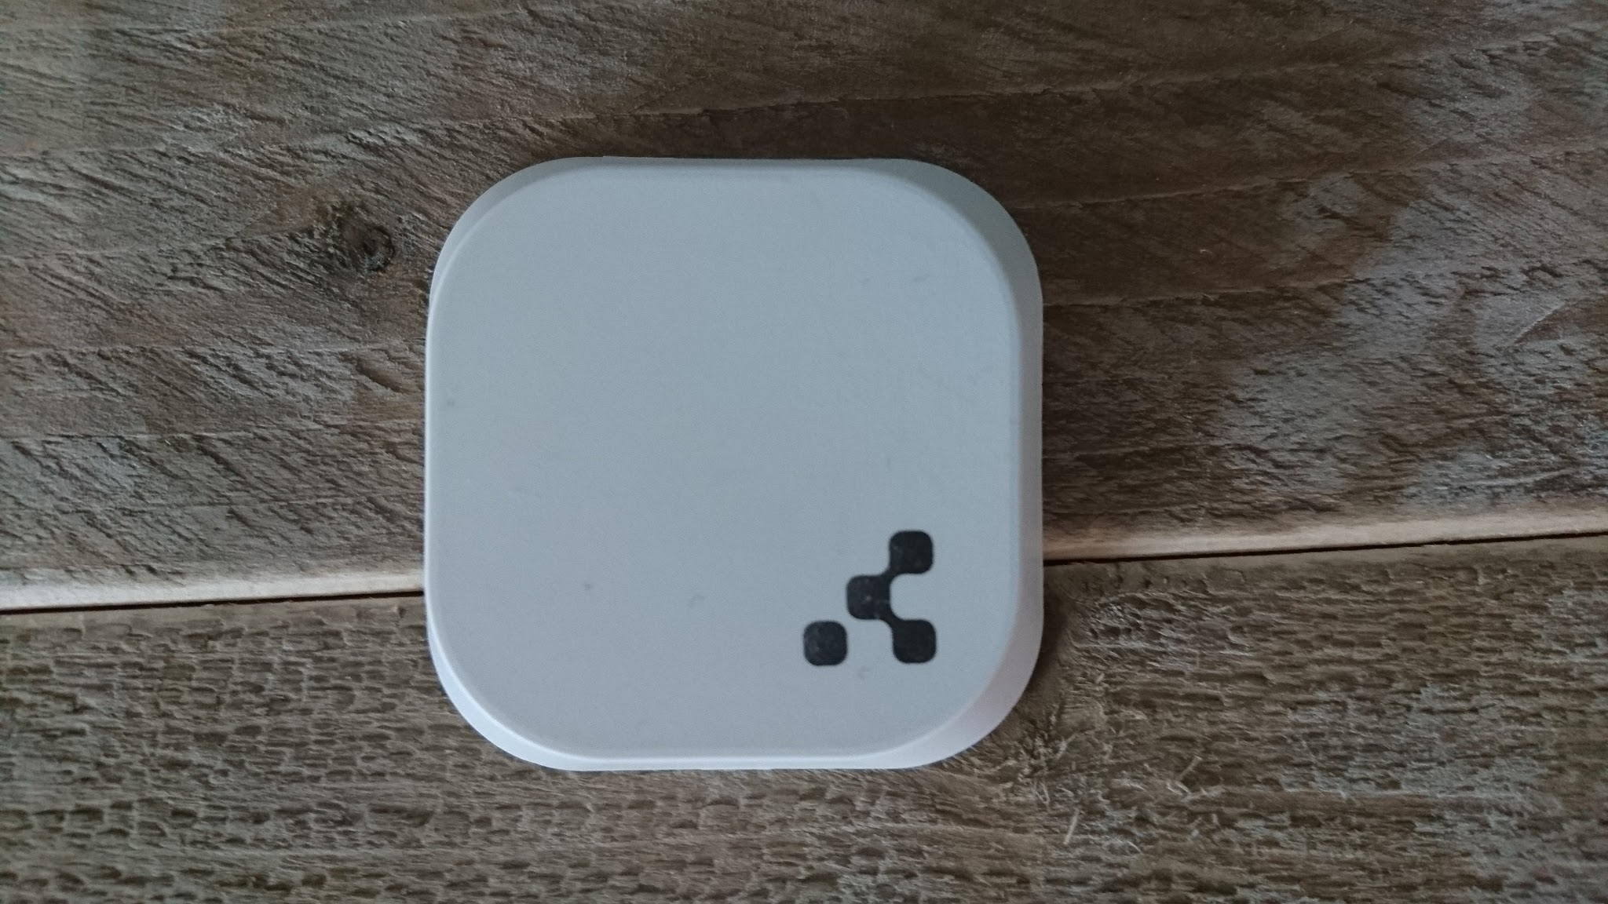

Notes:
With Ammarify, I will receive a notification via physical web and an app that we created will open the link with the video. I can also put and read comment. And the information is updated from the cloud, so we don’t need to change the beacons.

Slide 6
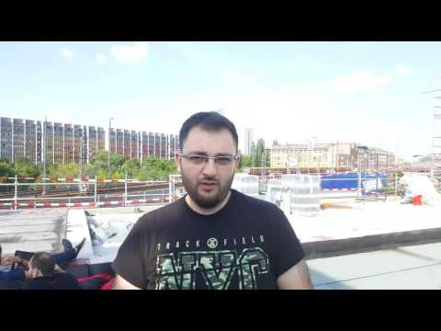

Slide 7
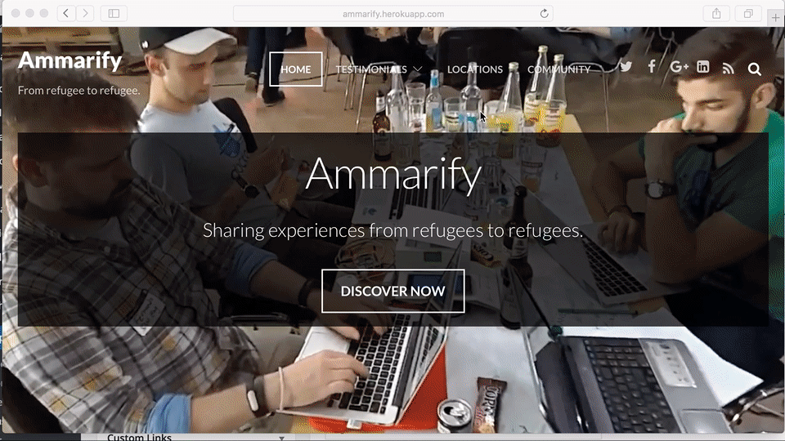
Notes:
You can also send a video to the platform, and request a new beacon. Then the organisation will place a beacon whenever you want

Slide 8
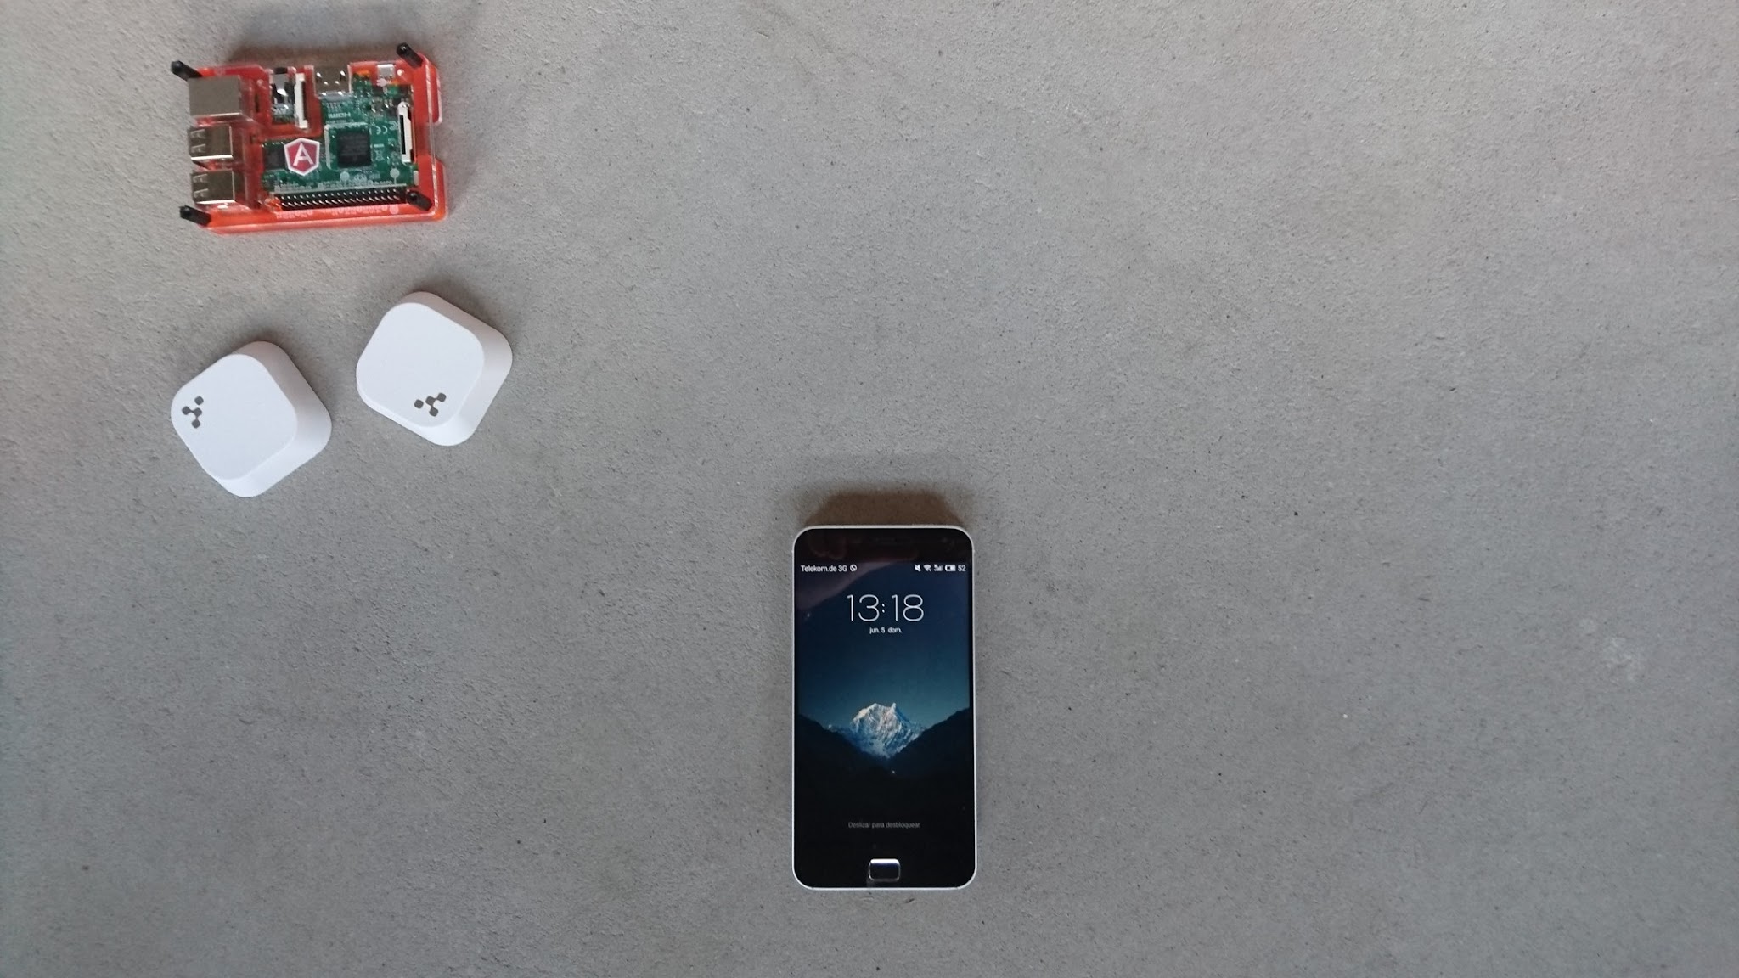





Raspberri Pi
Wordpress CMS integrating Facebook login and Youtube videos.
Kontakt.io Beacons
Kontakt.io Dev Tools
Deployed on Heroku
Android SDK
Notes:
Regarding the technology we used, here you can see that we used kontakt.io for the beacons, we deployed a web application in heroku with a wordpress CMS with social login with Facebook and Youtube

Slide 9
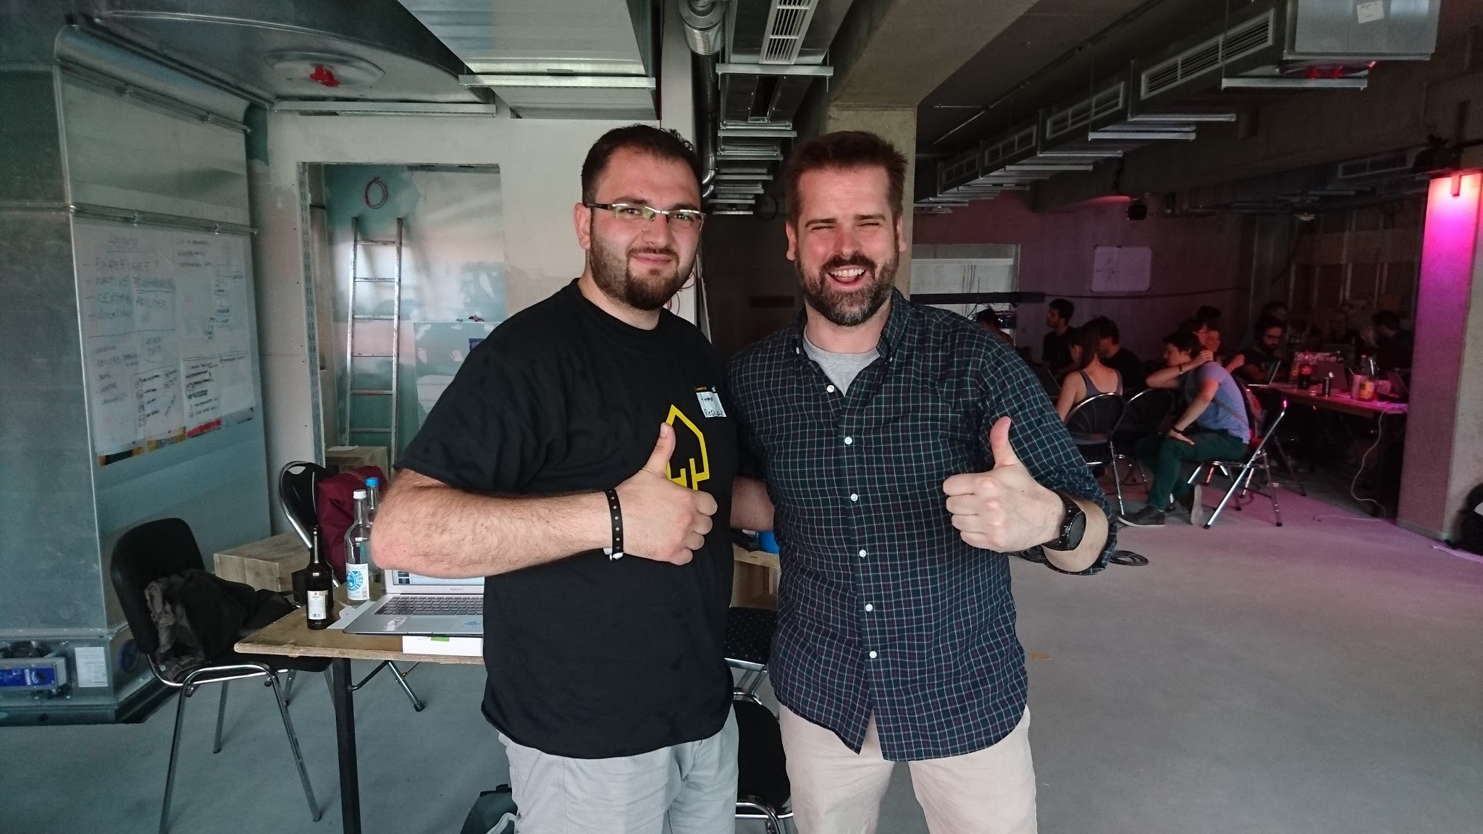


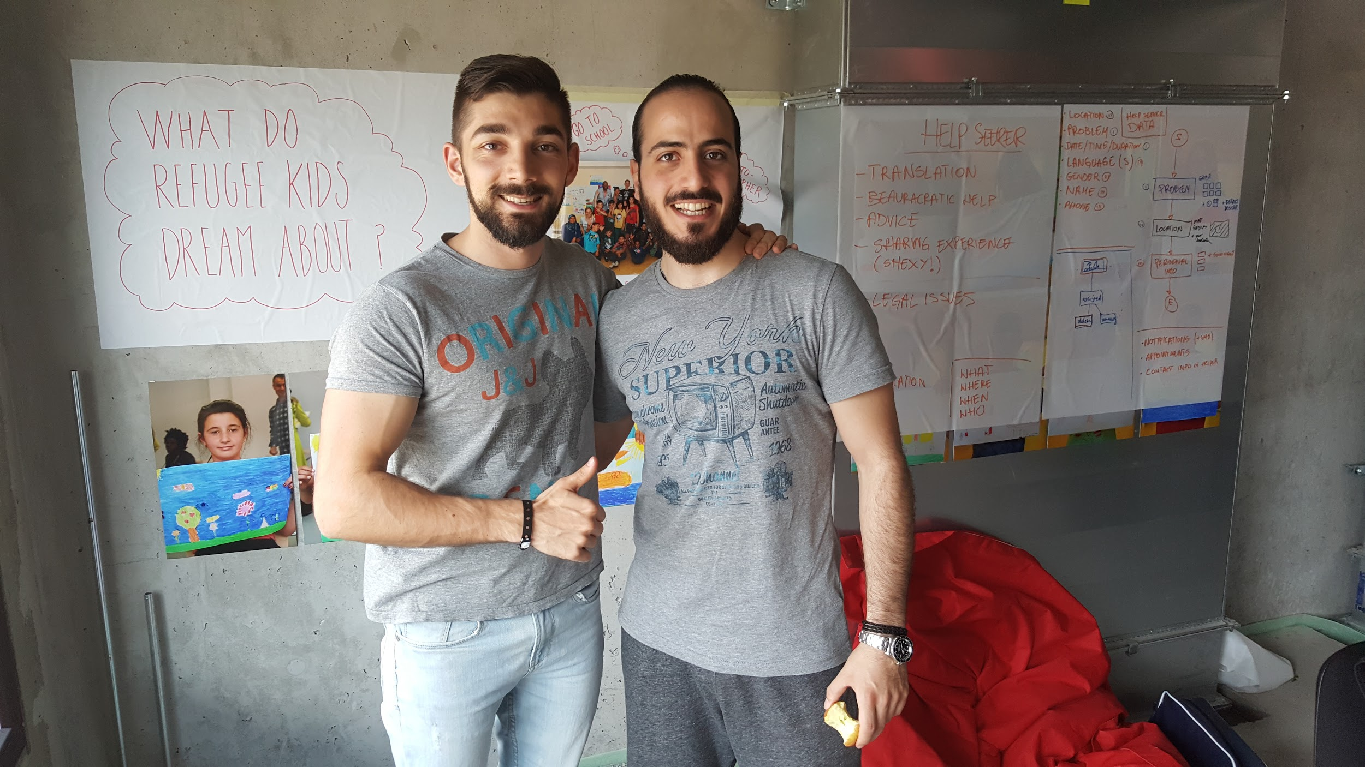

Credits
Fernando Álvarez-Uría <linkedin.com/in/fauria>
Javier Yuste Garcia <linkedin.com/in/javieryustegarcia>
Matthew Tuusberg <linkedin.com/in/tuusberg>
Jose Manzano Patrón <linkedin.com/in/josepedromanzanopatron>
https://github.com/fauria/spacehack-ammarify
http://ammarify.herokuapp.com

Slide 10
Ammarify
#SpaceHack: The Refugee Journey
Thank you!

Slide 11
Back-up slides

Slide 12
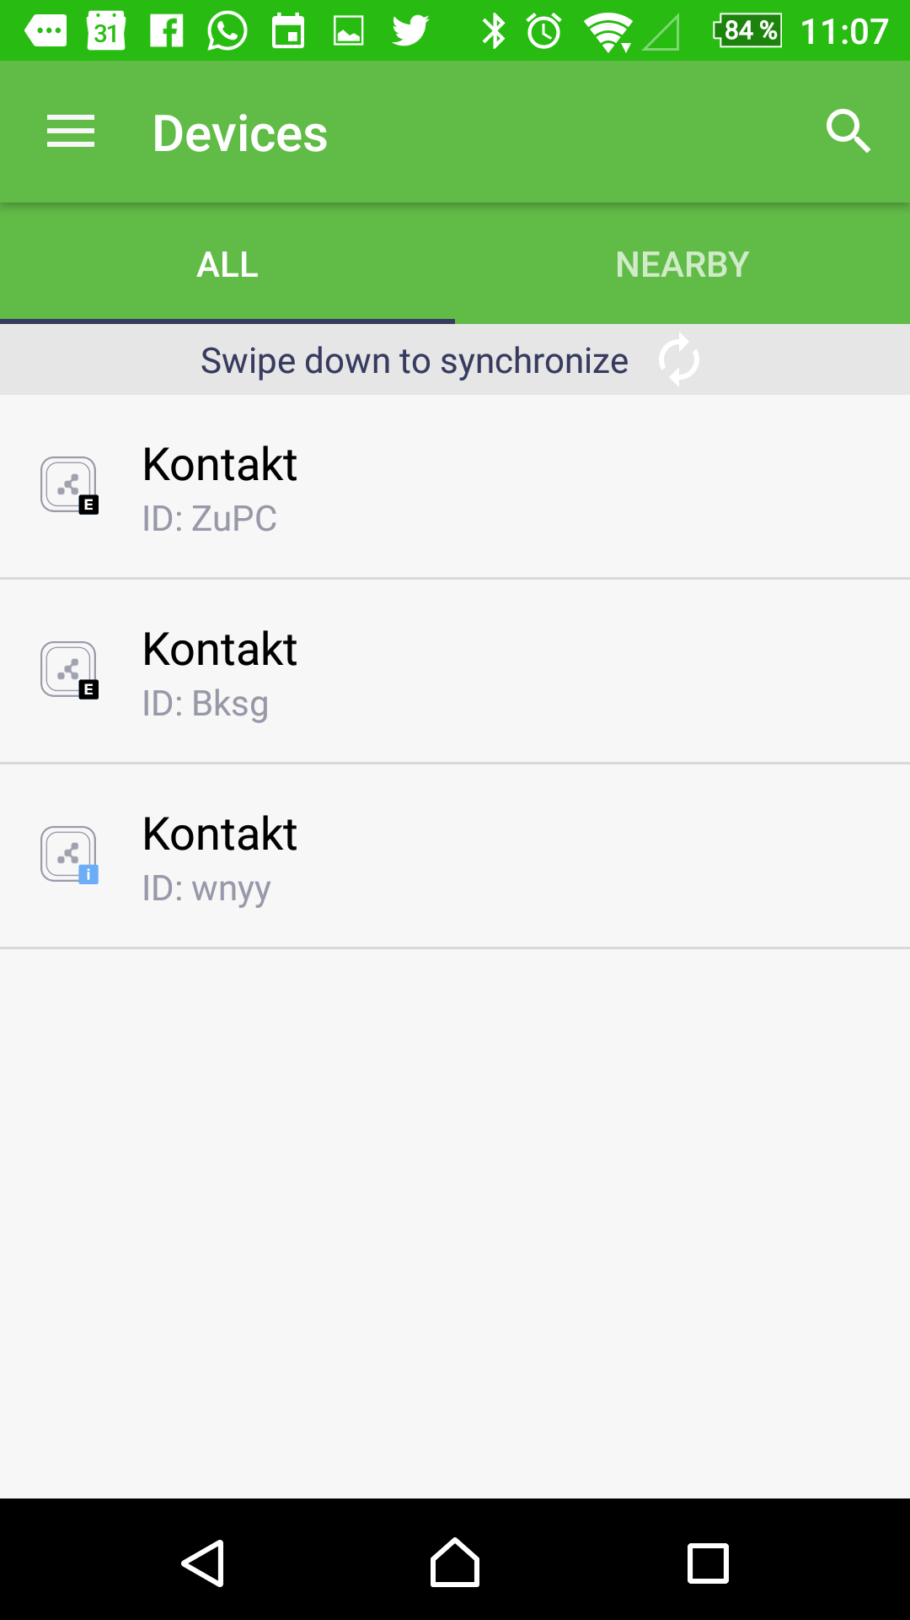
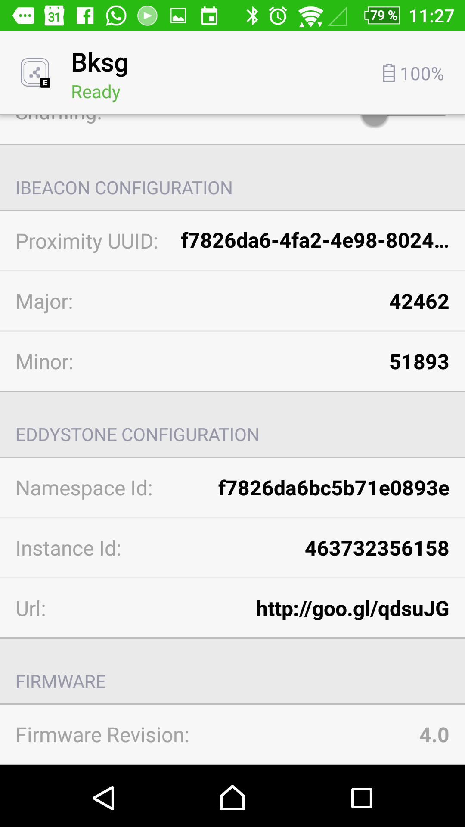
Admin App
Setup Beacons

Slide 13
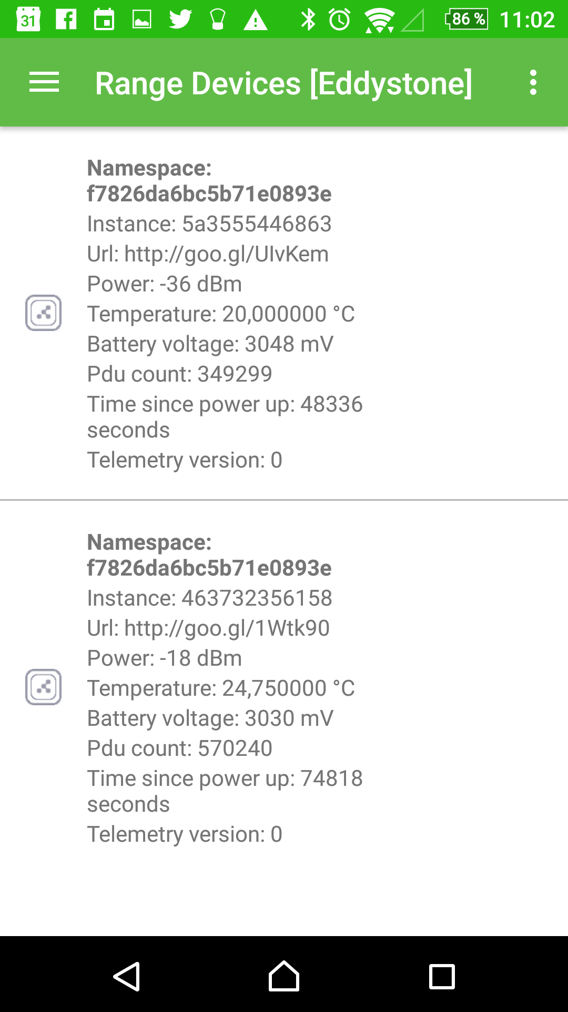
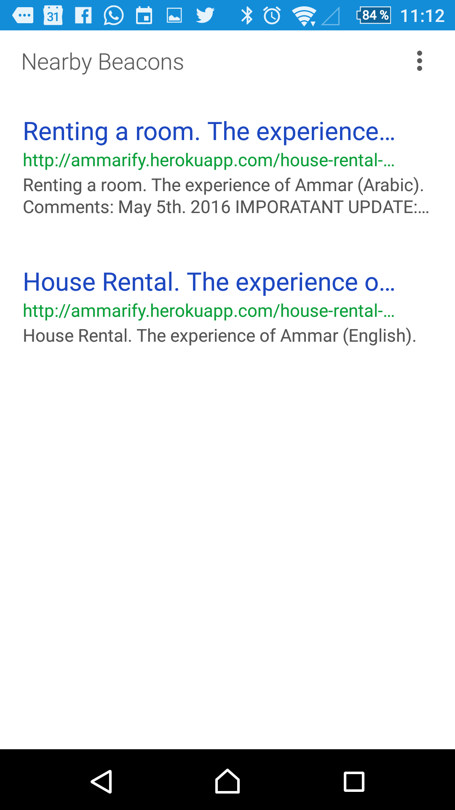
Dev App
Discover Beacons

Slide 14
Keywords
Helps refugees.
Solves uncertainty.
Gives assurance.
Offers support.
Enables physical web.
Deploys beacons.
Relays on IoT.
Generates feedback.
Results inexpensive.
Reduces bureaucracy.

Slide 15
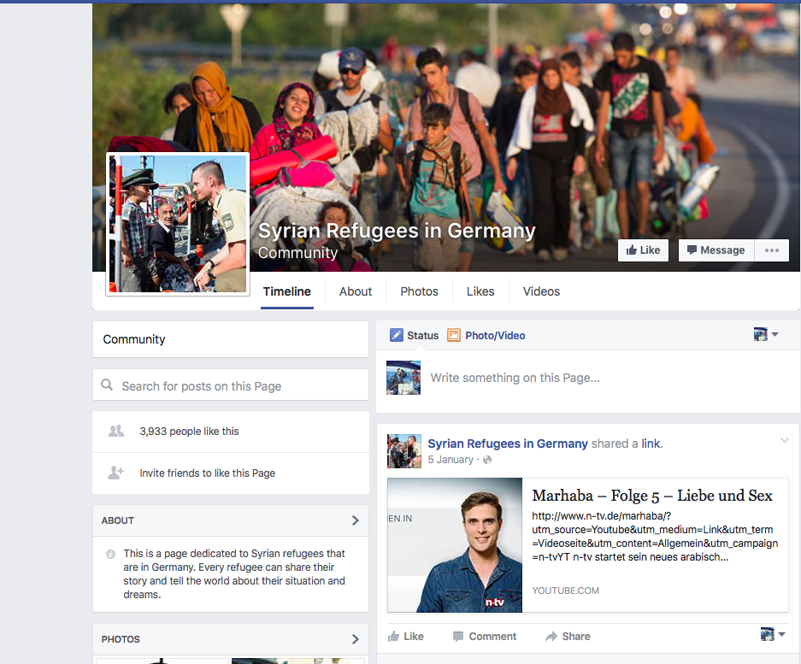

Slide 16
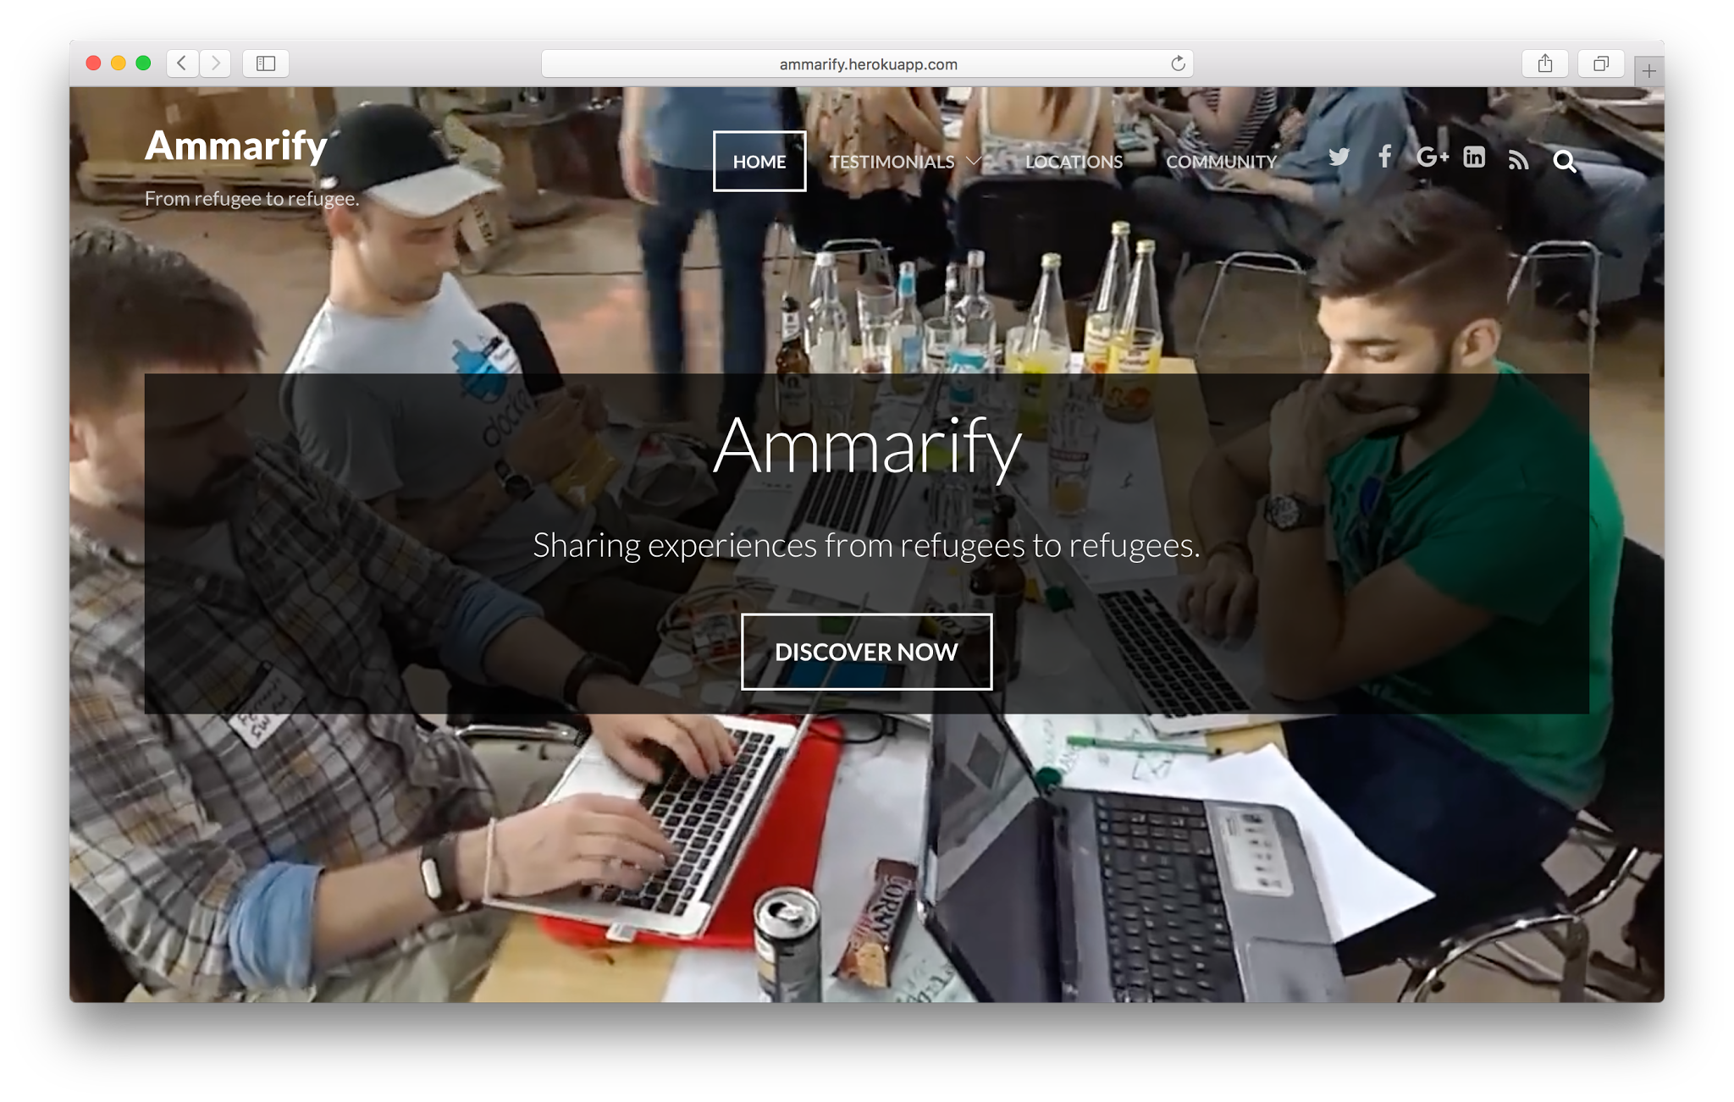

Slide 17
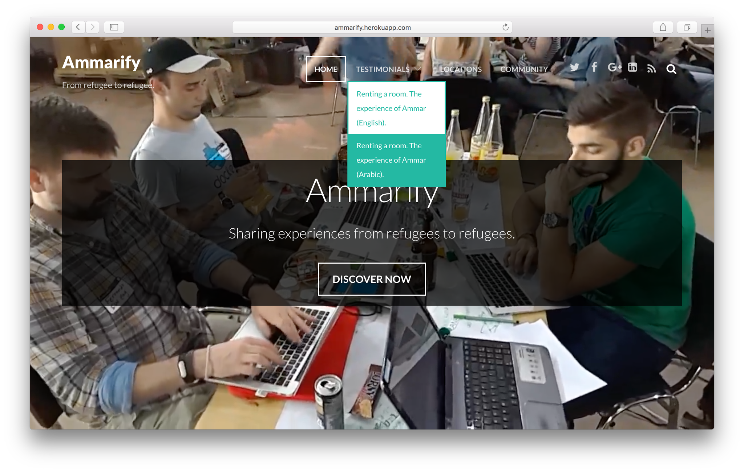

Slide 18
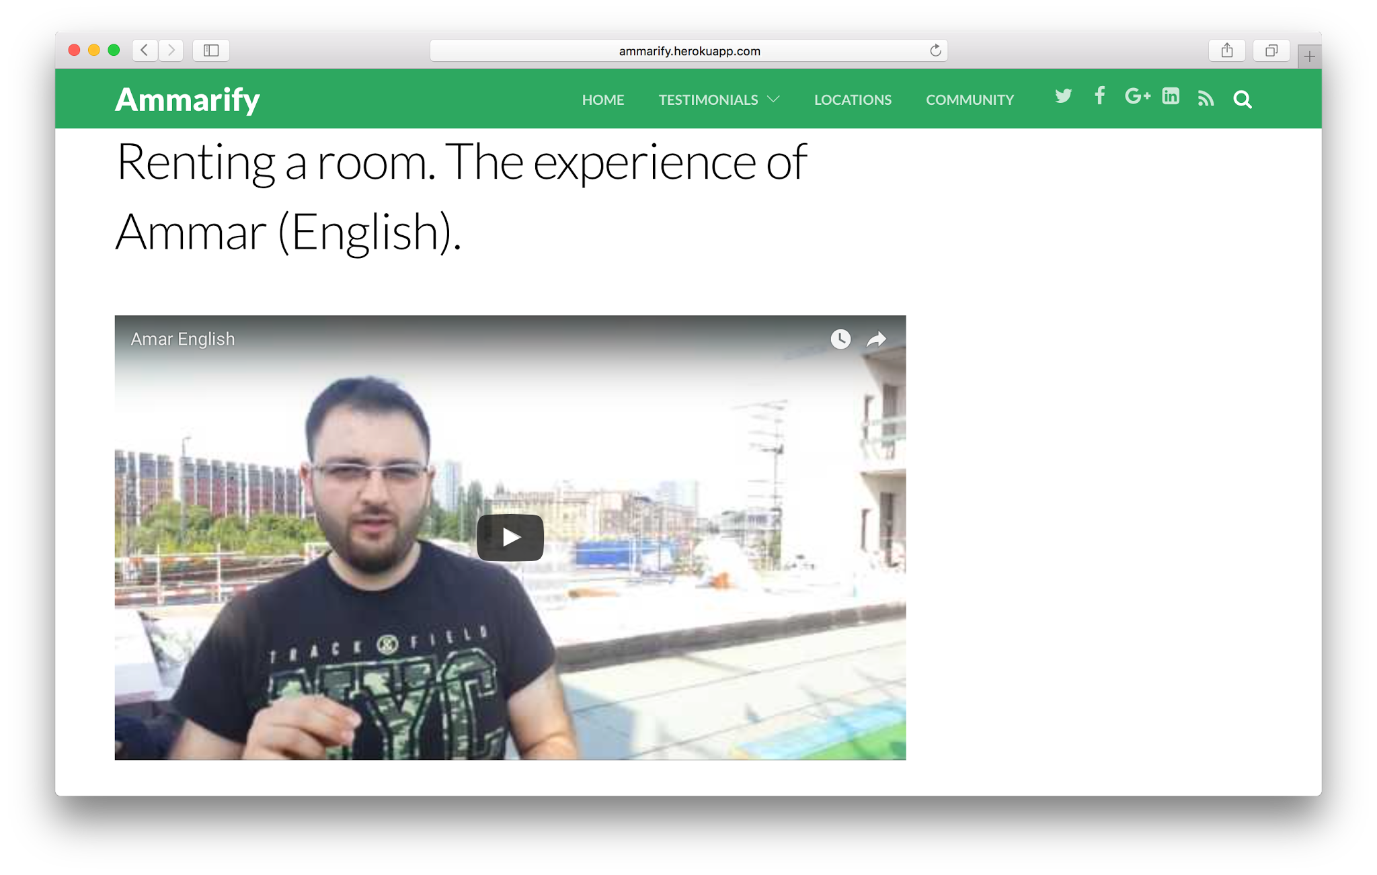

Slide 19
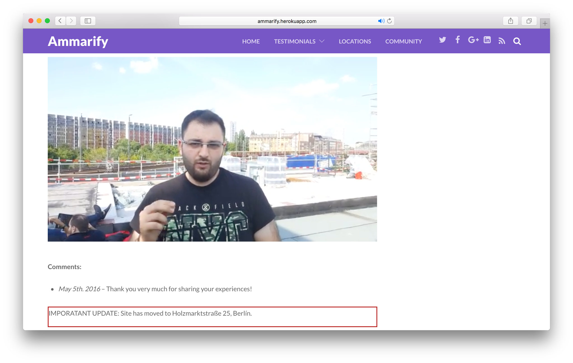

Slide 20
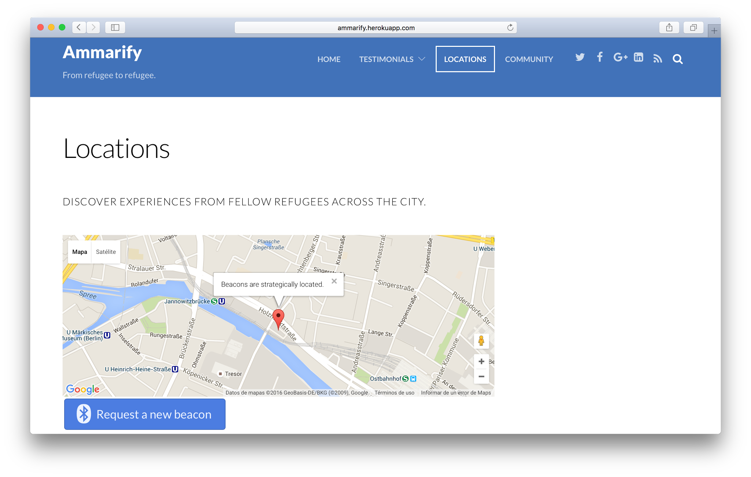

Slide 21
